Slide 1


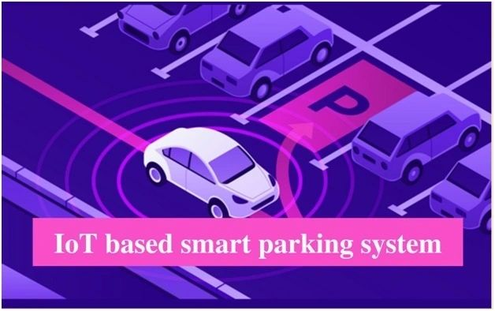
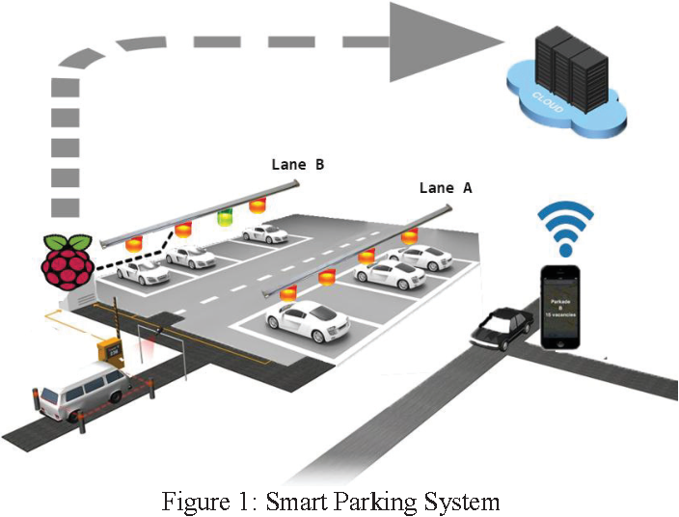
Welcome to our presentation on car parking using ultrasonic sensor technology. Discover how this innovative approach can revolutionize parking systems and enhance convenience for drivers.
Car Parking Using Ultrasonic Sensor

Slide 2

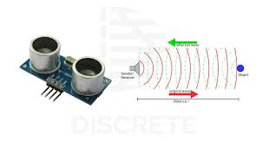
What is Ultrasonic Technology?
Ultrasonic technology utilizes sound waves with frequencies beyond the audible range to measure distance. It has various applications, including car parking systems, where it enables accurate detection and monitoring of vehicles.

Slide 3

How Does Ultrasonic Sensor Work in Car Parking?
1
Distance Measurement
An ultrasonic sensor emits high-frequency sound waves and measures the time it takes for the waves to bounce back after hitting an object, determining the distance between the vehicle and obstacle.
2
Signal Processing
The sensor converts the received echo into an electrical signal. Advanced algorithms analyze the signal to calculate precise distances and alert drivers of obstacles.
3
Visual and Audio Feedback
Car parking systems equipped with ultrasonic sensors provide visual indicators, such as LED displays, and sound notifications to assist drivers in navigating parking spaces safely.

Slide 4
Advantages of Ultrasonic Sensor in Car Parking
Accurate Distance Measurement
Wide Angle Coverage
Ultrasonic sensors offer reliable distance measurements, ensuring precise parking and minimizing the risk of collisions.
With their wide detection range, ultrasonic sensors can cover a significant area around the vehicle, improving parking efficiency.
Robust in Different Conditions
Enhanced Driver Experience
Ultrasonic sensors perform effectively in various environmental conditions, including low-light and adverse weather situations.
By reducing stress and uncertainty, ultrasonic sensors simplify the parking process, providing drivers with a smoother parking experience.

Slide 5
DisAdvantages of Ultrasonic Sensor in Car Parking
Limited range
Ultrasonic sensors can only detect objects that are within 8–15 feet, which may not be enough in some situations.
Environmental sensitivity
Ultrasonic sensors can be affected by environmental conditions like temperature, humidity, and air turbulence
.
Appearance
Ultrasonic sensors are usually installed on the outside of the car, which can leave indents on the front or rear of the car
External noise
Ultrasonic sensors are audible, so they can be affected by external noise like honking cars or construction.

Slide 6
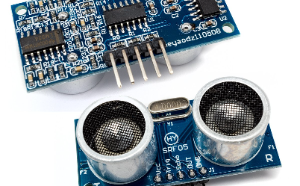

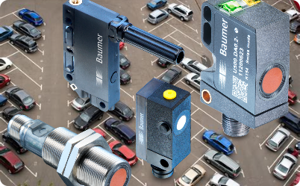
Design of Ultrasonic Sensor for Car Parking
Compact and Mountable
Seamless Integration
Innovative Sensing Features
Ultrasonic sensors designed for car parking are compact and can be easily mounted on vehicles or integrated into parking infrastructure.
The design of ultrasonic sensors allows seamless integration with existing parking systems, offering an upgrade for traditional parking solutions.
Modern ultrasonic sensors incorporate advanced features such as obstacle recognition, adaptive parking assistance, and even automated parking capabilities.

Slide 7

Limitations of Ultrasonic Sensors in Car Parking
1
Sensitivity to Noise
2
Reflection Interference
3
Limited Range
Ultrasonic sensors can be affected by ambient noise, which may lead to inaccurate distance measurements if not properly mitigated.
Ultrasonic sensors have a range limitation, typically within a few meters, making them more suitable for close-range parking applications.
Highly reflective surfaces, such as glass or polished metal, can cause echoes that interfere with distance calculations, potentially leading to false readings.

Slide 8

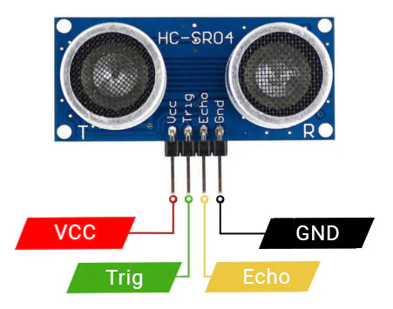
Conclusion
Car parking using ultrasonic sensor technology offers numerous advantages, from accurate distance measurements to enhanced driver experiences. Despite their limitations, ultrasonic sensors provide a reliable solution to streamline and optimize parking systems for a more convenient future.
THANK YOU

